Slide 1
Person Centered Planning --
As Established in “The State Plan: A Blueprint for Change”

Slide 2
Where Did It Come From?
The term “person-centered planning” actually comes from a family of planning techniques first created for use with developmentally challenged persons…it includes multiple methods for constructing a recovery and life plan that includes key elements of consumer & family choice, a unified plan (across agencies and providers) integrated into a single plan, managed by a single care manager or coordinator, and informed by the consumer and/or advocate at every step of the service process.

Slide 3
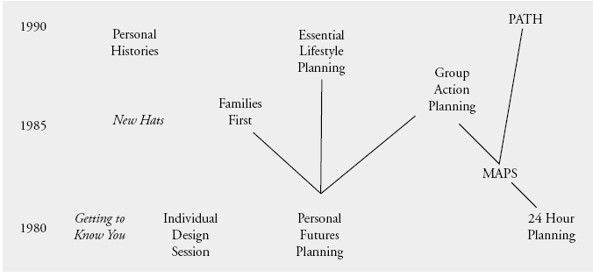
Evolution of Person Centered Planning (from O’Brien & O’Brien, 2000)

Slide 4
Core / Key Values (State Communication Bulletin#34) – Slide 1 of 2
Strength-based, future oriented– focus is on strengths and recovery
Supports consumer empowerment, meaningful options and informed choice
Honors consumer goals, aspirations and lifestyle choices that promote dignity, respect, interdependence, mastery and competence

Slide 5
Core / Key Values (State Communication Bulletin#34) – Slide 2 of 2
PCP sees individuals in the natural context of their culture, ethnicity, religion and gender…all elements are acknowledged, supported and valued in the planning process
“Families/parents as Partners” – PCP creates a collaboration between consumer, family and providers so that they are involved from the beginning, acknowledging the legitimate contributions of all parties

Slide 6
Person Centered Planning Reconfigures the Relationship Between Providers and Consumers
NO!
Agency
Yes!
Agency
Program
Program
Program
Consumer/family
Agency
Agency
Consumer/family

Slide 7
3 Notable Changes from Deficit or Problem Focused Planning
Future focus on lifestyle experiences and needs, not pathology and diagnosis per se
Moves service planning outside the typical menu or “orbit” of services—expands to include natural environmental supports
Focuses on capacities as the cornerstone for growth – strengths, skills, capacities and aspirations

Slide 8
Roles of Families and Consumers?
“Hire” their providers and care managers
Plan services in partnership
Advise agency staff, other providers, consumers, etc. on care needs, values, expectations and perceptions
Serve as effective and ongoing advocates

Slide 9
Essential Elements (Communication Bulletin)
Unified Life Plan – the umbrella under which all planning for services, supports and treatment occur
Planning team is inclusive of consumer/family, professionals and paraprofessionals, and honors the need for flexibility, scheduling, location, etc.
Goals and strategies are designed to meet life outcomes, not to reduce deficits – not a pathology-repair model
Addresses health and safety (e.g., housing, income, job/education, etc.) needs in addition to treatment and other support needs
Plans for how to work with individual/family disagreement
Opportunities and realistic ways to modify/change the plan
Adequate and accurate documentation of the planning process as well as the plan
Acknowledgement of the indicators (individual as well as systemic) that reflect a person-centered approach

Slide 10
Who’s On The Team?
Consumer, family an/or designated person of competence
Professionals and paraprofessionals who may be in both the formal and informal support systems
Others who enter as the plan evolves—it is a Life Plan, it evolves dynamically over time, adjusting for new goals and objectives as agreed upon by the planning team
In the “Children’s World”, this would be the Child and Family Team – and is also often referred to as a child’s “Circle of Support”

Slide 11
What’s The Focus of the Team?
As noted in the Communication Bulletin, 3 “layers” or levels of supports must be considered:
Personal Resources-the person’s own resources (skills, abilities & competencies)
Natural Supports-family, neighbors, co-workers, friends and others who may lend informational, financial, emotional or other tangible support to the consumer
Community Resources-opportunities to connect to structures or organizations where the consumer can maximize the chance for gaining life skills, coping supports, and improving recovery

Slide 12
Other Elements and Characteristics of An Effective Person Centered Plan
PCP has to be realistic – must address health/safety and basic needs first and foremost
Should include options (informed choice), not prescriptions
Should be specific in terms of measurable objectives, strategies, time frames and responsibilities
Should include regular and flexible options for review, dispute/conflict resolution, and updates

Slide 13
Life Plan Vs. Traditional Service Plan
Rehabilitation View
- Focus on impairments or deficiencies
Problems lie within the consumer
Solution? Requires professional intervention
Who’s the person? The client/consumer
Who’s in charge? The professional
- How are results/success defined? Reduced impairment or pathology as judged by professionals
Life Plan or PCP View
Focus is on optimizing life functioning
Problems lie in the environment (environment doesn’t promote coping and competencies)
Solution? Remove barriers and/or expand advocacy and opportunities for recovery
Who’s the person? Person/citizen/consumer
Who’s in charge? Person / citizen / consumer
How are results defined? Living independently or optimally according to life plan and effective match of supports to needs

Slide 14
For Additional Information
See the Person Centered Planning Education web site at Cornell University: http://www.ilr.cornell.edu/ped/tsal/pcp/index.html
Call Cumberland County Mental Health Child and Family Services @ 323-2311, and learn more about the Community Collaborative, or
Call Cumberland County CommuniCare, Inc. @ 222-6089 and ask to speak to someone about the Community Collaborative
THANK YOU!

